Slide 1
Tips, Tricks and Techniques 4
Creative

Slide 2
No rules Anything goes
But it still needs to appeal to someone
Preferably not just you
Have had two expert workshops on creative photography over the past few years
Eva Polak
Gail Stent and Judy Stokes
Review what they covered and then see what members have been doing creatively
Maybe slip in a You Tube video
No time for in field work but can play with your cameras as we go along

Slide 3
Eva Polak
Examples of a range of in camera techniques

Slide 4
Vaseline smeared glass plate in front of lens

Slide 7
Multiple Exposures Set camera to exposure a series of images on to the same sensor file

Slide 9
Long Exposure >1sec

Slide 10
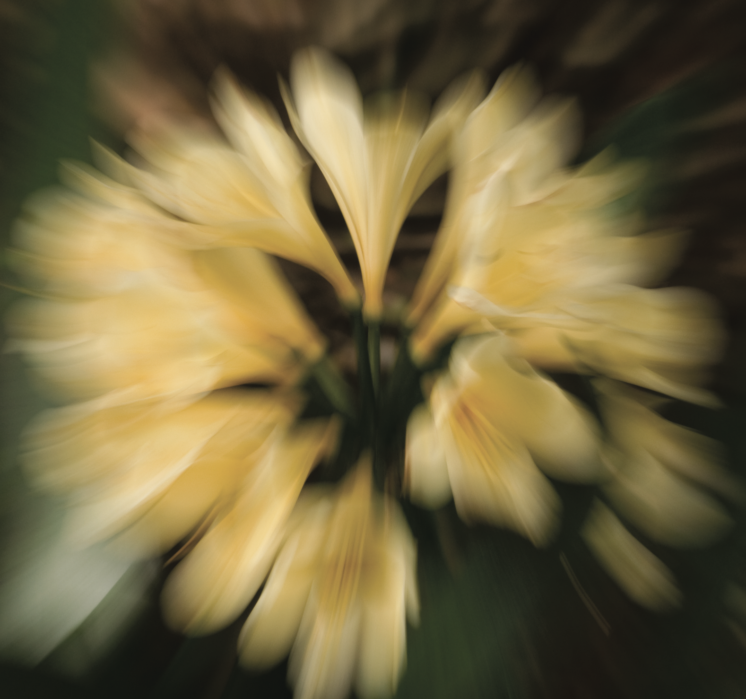
Zoom Burst Slow shutter speed / rotate lens

Slide 11
Defocussing ie not focussing

Slide 12
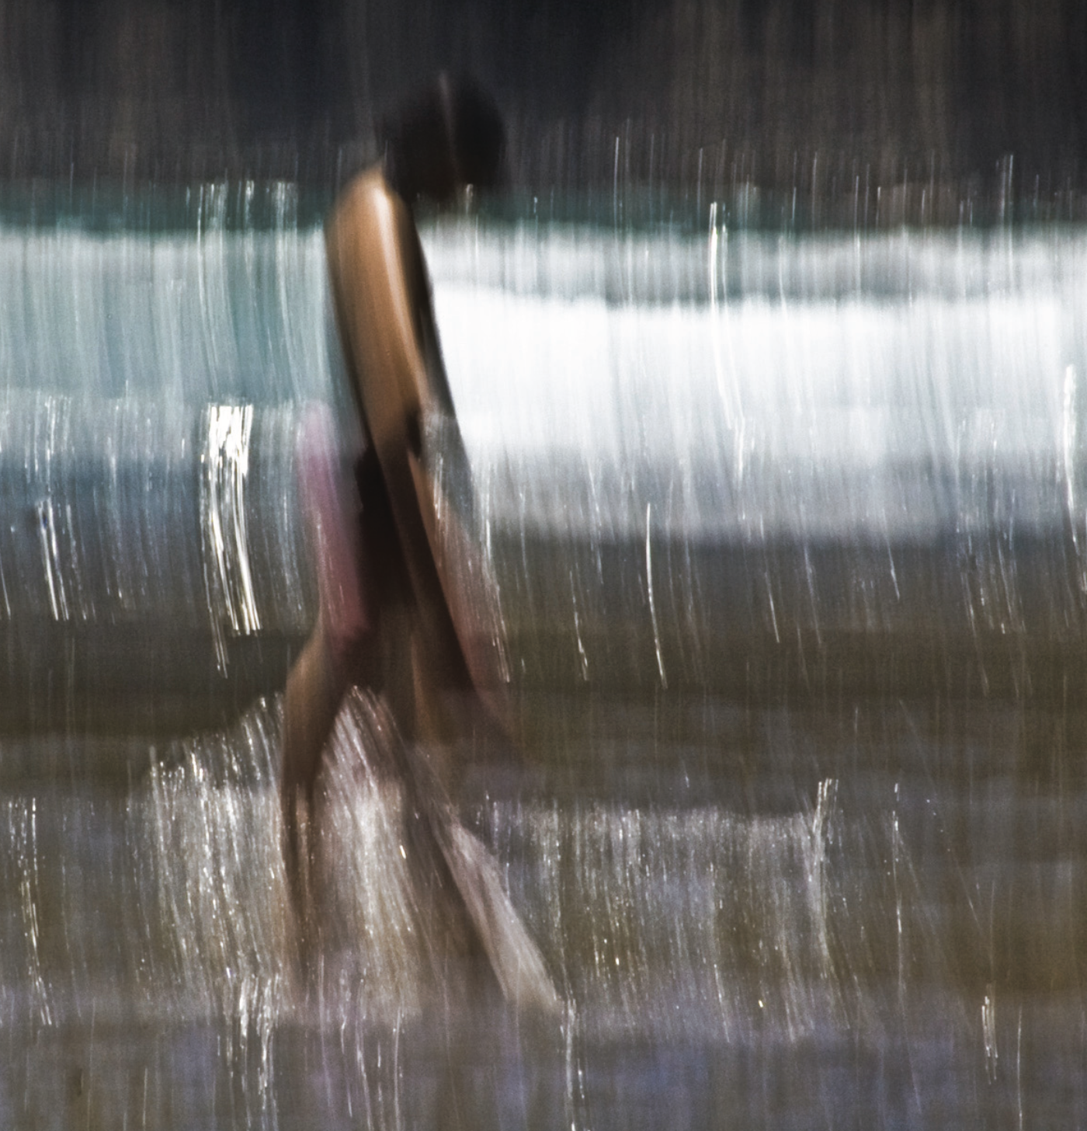
Camera Movement Intentional

Slide 14
Shallow Depth of Field Low aperture

Slide 16
Long exposures with movement

Slide 19
Reflections

Slide 20
Rain / Water

Slide 22
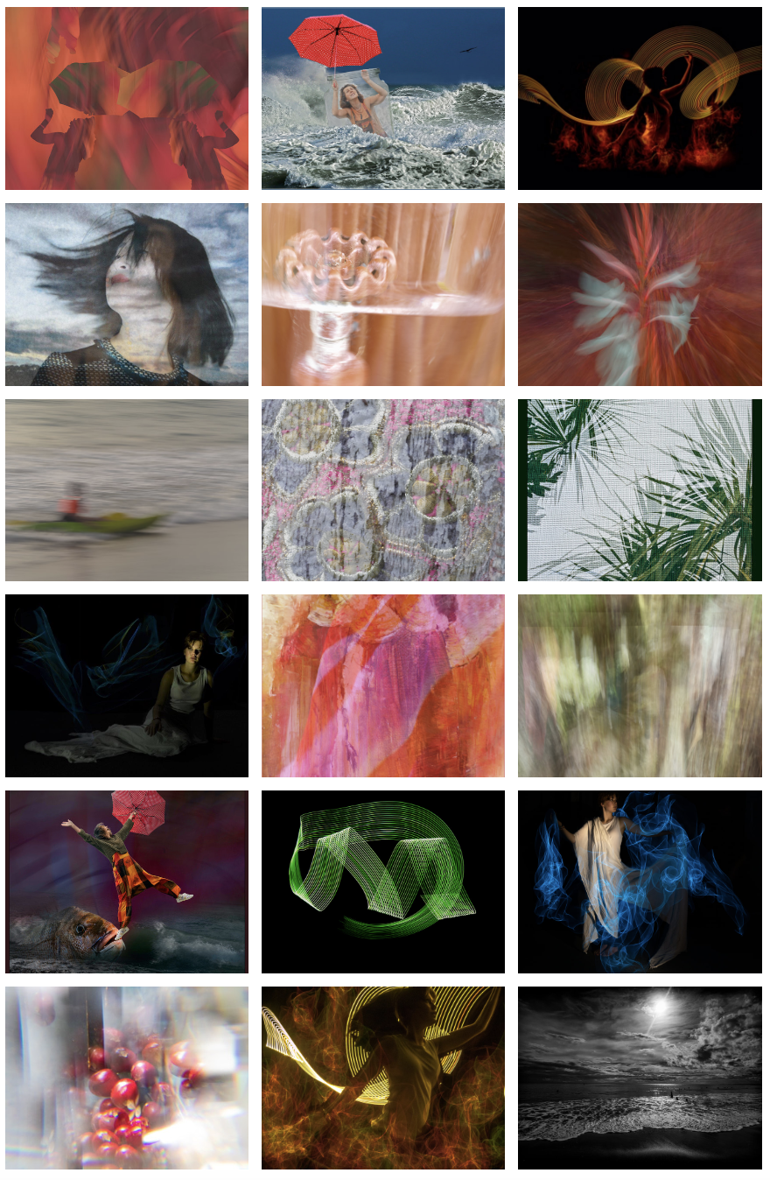
Gail and Judy
Some of the same techniques – eg ICM
But more emphasis on multi media and composities and light painting
And absracts
Look at the images we posted on our web site after their workshop
https://www.whanganuicameraclub.org.nz/
Handouts

Slide 23
Creative Focus National Salon run by Pukekoe CC
Worth looking at their awardees from 2021 and 2022
https://www.youtube.com/watch?v=qltT7QA7oF8
Start at 7.30

Slide 24
A different kind of photography
https://www.youtube.com/watch?v=T2rGplgQ3cA&t=593s
Start at 1.30

Slide 25
Post Processing
Can find many creative filters, actions and techniques for enhancing or even creating new images on line – explore
Also AI techniques are emerging that essentially remove the need for photography – more about computer generated art
For club assessments best to ensure all the elements in any image originated from your camera

Slide 26
Share what members have been doing with their creative photography
Up to 6 images each
Describe the technique you used and your experience of it
My examples on the wall

Slide 27
Wrap up

